Slide 1

Analyzing Bike sales across the globe

Slide 2

AGENDA
Overview
Data Collection
Analysis
Interpretation
Recommendations

Slide 3

Overview
The purpose of this project is to analyze the general tendencies of bike sales by identifying trends using descriptive statistics.
A dataset with 18 features and 113,036 observations was used.
Some questions that will be answered by the end of this project include:
What is the spending by age and gender?
What country is the best place to sell bikes?
Which month of the year have the highest/lowest sales?

Slide 4

Data Collection
The dataset used for this project was taken from Kaggle.com labeled as “Bike Sales in Europe”.
Data preprocessing and cleaning were performed to ensure no missing/duplicate data was included.
The dataset contains information on sales data from a bike retail chain located in Australia, Canada, France, Germany, United Kingdom, and the United States of America from 2011 to 2016.

Slide 5
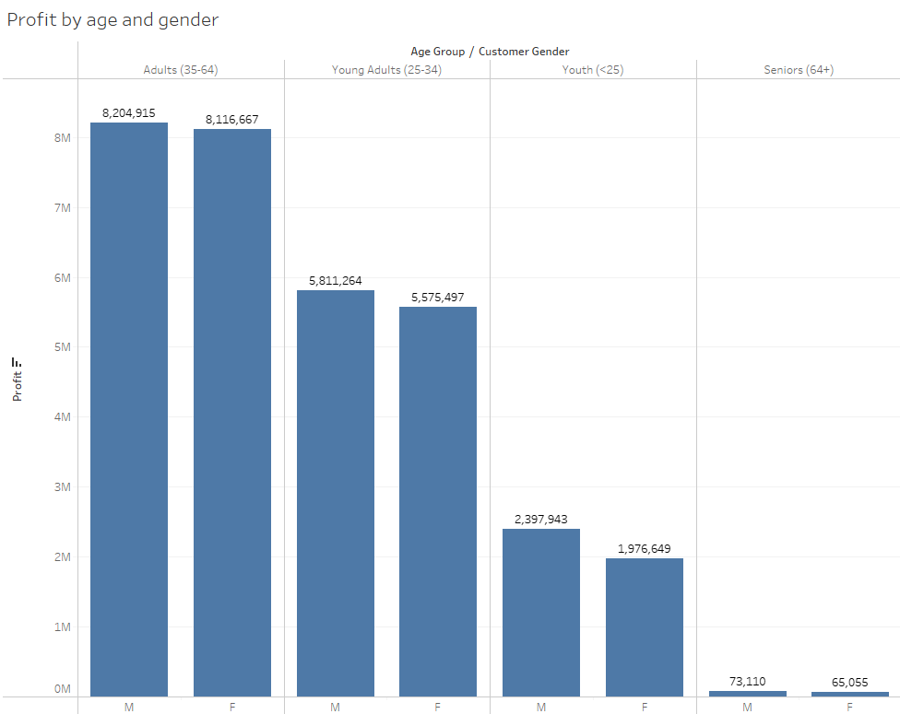
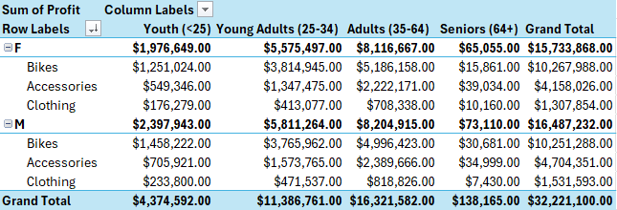
spending by age & Gender
These images show the profits earned from bike equipment sales categorized by gender and age.
The age group with the highest spendings come from Adults ages 35-64.
In all age groups, men are seen to have a higher spending on bike equipment compared to females.
The category that brings in the most sales is the “Bikes” category.

Slide 6
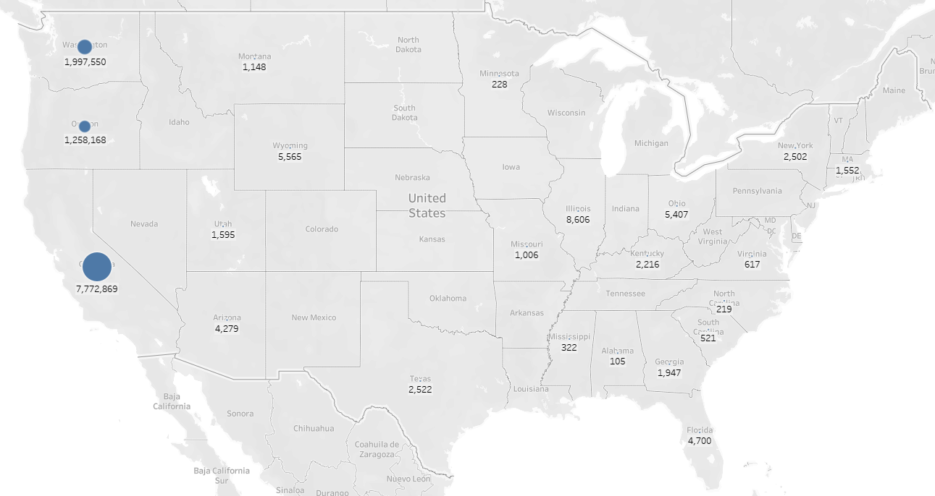
Bike sales performance by country: United States of America
Note: there is no sales data provided from Alaska and Hawaii.

Slide 7
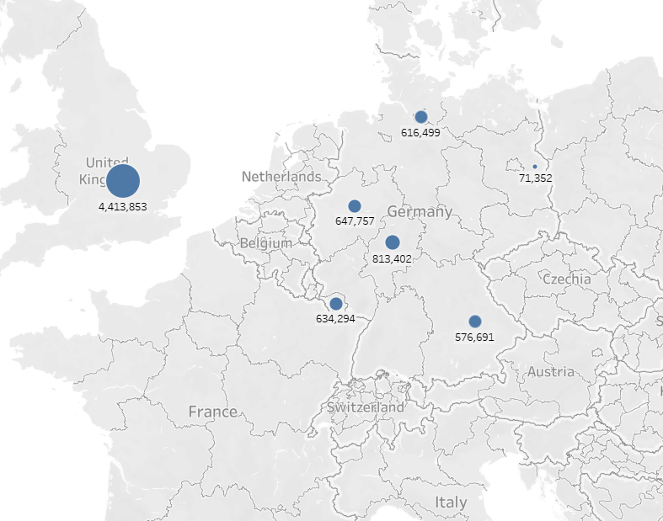
Bike sales performance by country: France, Germany, & United Kingdom

Slide 8
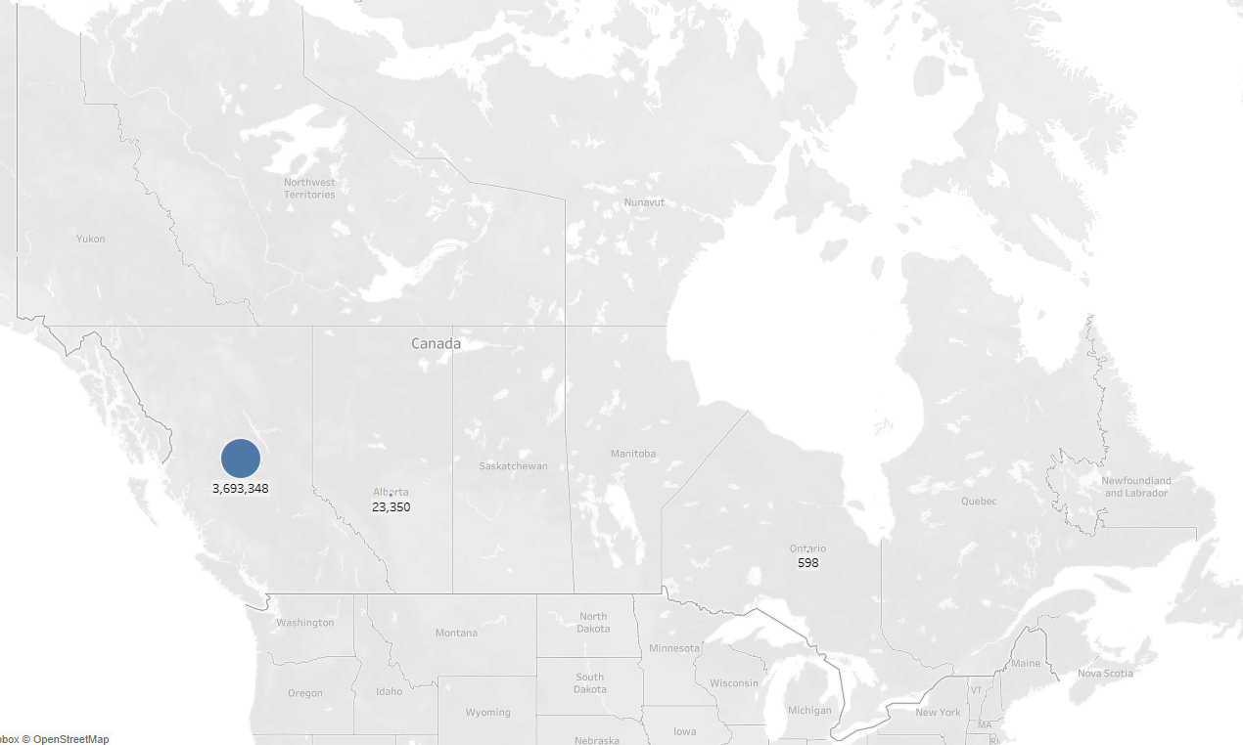
Bike sales performance by country: Canada
Note: data on bike sales were only provided for the shown territories.

Slide 9
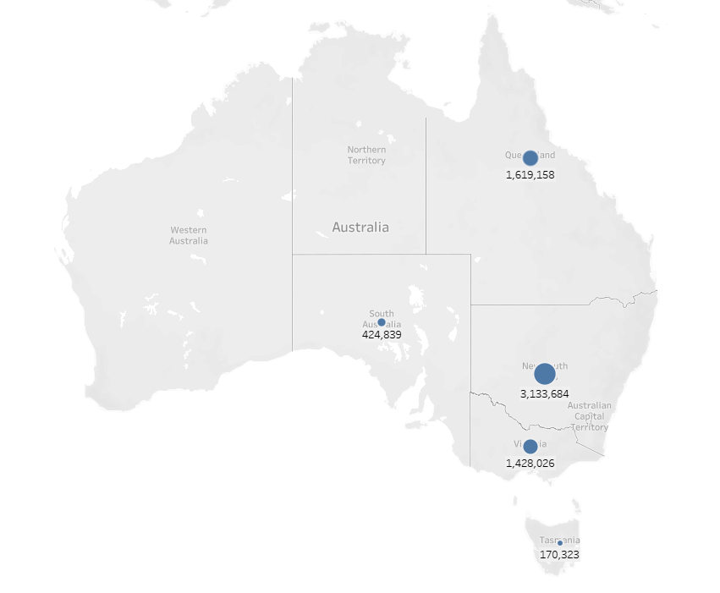
Bike sales performance by country: Australia

Slide 10
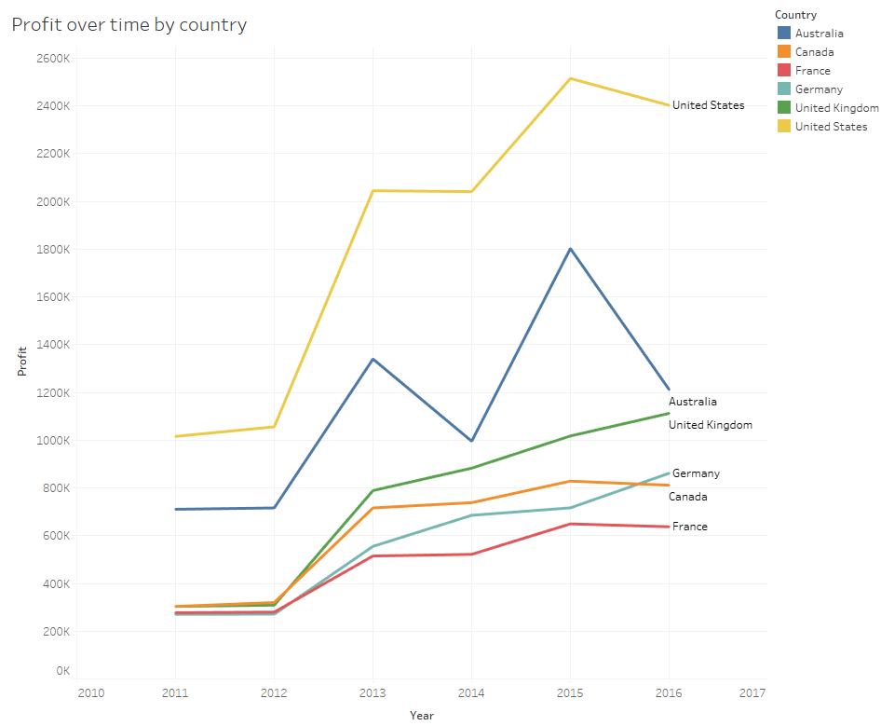
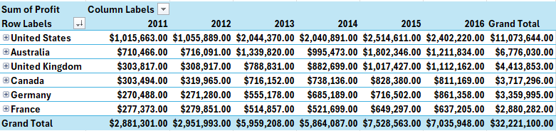
Performance by country overview:
These images show the profits earned from each country over time.
The country with the highest sales is the United States. However, it seems like sales here are experiencing a damped trend.
California brings in the highest sales from the United States.
Based on the graph, Australia seems to have a seasonal trend with the next year projected to return large profits.
The United Kingdom is experiencing an S-curve trend

Slide 11
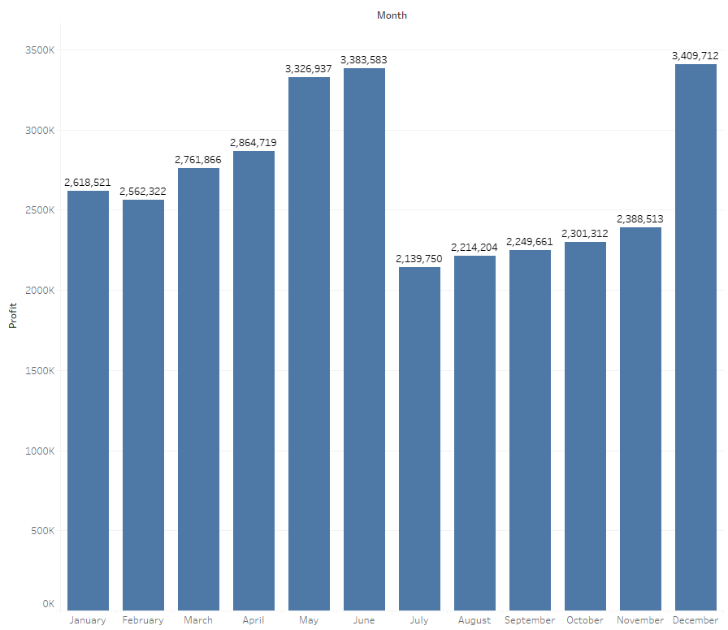
Performance by month overview:
This image shows the sum of the profits earned from each month.
The top 3 months with the highest sales are December, June, and May.
Possible explanations for these months being the most popular include:
Christmas (gift giving)
Summer season (outdoor activities)

Slide 12
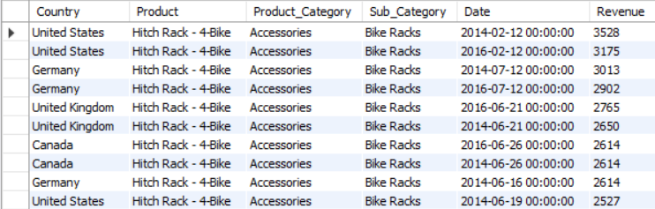
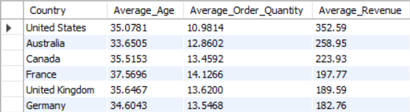
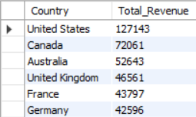
Extra information
The average age, order quantity, and revenue for each country listed in order of highest revenue to lowest for the year 2015 (the company’s best performing year).
Top 10 days where bike sales were the highest with the company’s highest selling demographic (males aged 35-64).
The sum of revenue for each country for products sold in the top 3 busiest months (May, June, and December).

Slide 13

Interpretation
With our three research questions answered, we find that:
Males tend to spend 4% more than females on bikes and accessories.
Adults ages 35-64 bring in the most profits from the specified age groups.
The United States bring in the most sales out of the countries with bike stores.
The three months with the highest sales are May, June, and December.

Slide 14
Recommendations
Focus on sales in the United States since bike sales are the highest there, specifically in the west coast region.
Increase bike promotions/marketing campaigns during the months with highest sales (May, June, and December).
The 4% difference in profits between Males and Females can be disregarded, meaning that both men and females are just as likely to purchase bike products.
The main target demographic for this company seem to be individuals aged 35-64. Some characteristics of this demographic include:
Middle aged individuals
Married with children
Established careers
Homeowners
Higher end of the age range entering retirement

Slide 15

THANK YOU
Jonathan Cao
626-782-2079
jonathancao38@gmail.com
www.linkedin.com/in/jonathancao38

